Slide 1
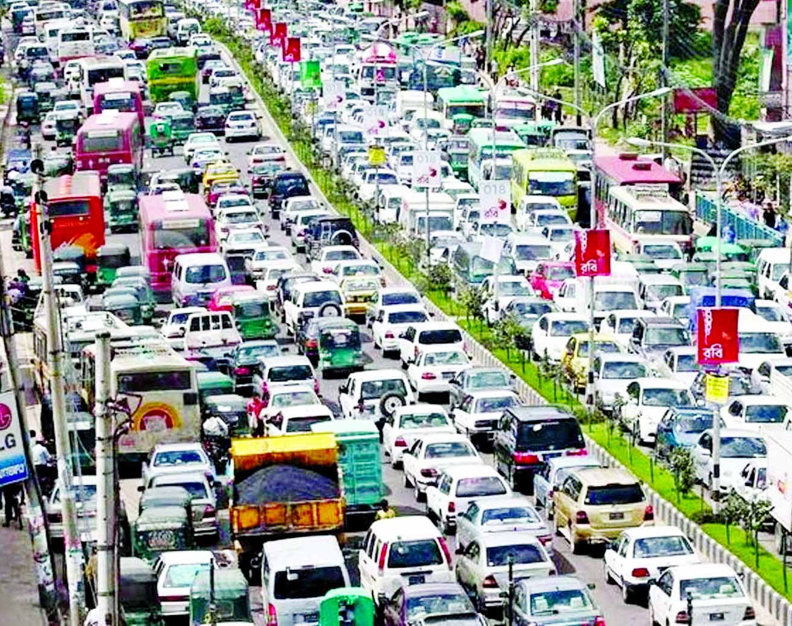
Traffic Problem
Problem type: Regression

Slide 2

Traffic is one of those annoying problems that affect many of us living in urban settings. One of the causes of traffic is the increase in urban populations. While the infrastructure is old and can only accommodate a limited population there is an influx of residents in search of livelihood and opportunities.
Problem Statement
Predict No. of Vehicles
providing a better understanding of traffic patterns that will further help in
traffic signal time management to reduce travel time
building an infrastructure or
Rearranging detour or One way road network plan

Slide 3
Target: Vehicle Frequency
Solution is
The Decision maker,
Potential frequency of vehicles for different days
Target
No of Vehicles
Calendar
Weather
Demographic
What Else?
Business Day
Weekend
Hours of the day
Events-holidays
Location
Area Population
Commercial Frequency
Temperature
Rainfall
Notes:
Education budget reduced drastically due to increased energy crisis and economic recession, as a result all schools aren’t able to get resources they need for keeping good pass rate

Slide 4

Traffic Data.

Slide 5

So lets Run with a Robot AI…..

Slide 6
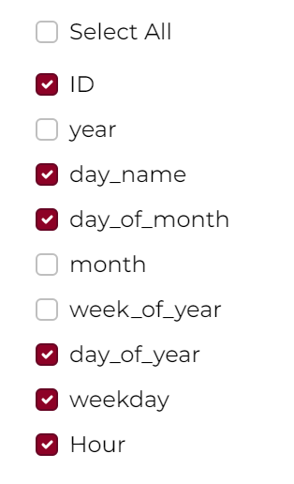
Get the Traffic decision with 4 steps
Login
Name Project “Transportation”and Solution Name “Traffic Optimization”→ Version 1.0→ Click create project
Data
Build Model
You will land inside Data tab click on “Add Data”
Name your data “Traffic Data” → upload the traffic_jun_may2017_train.csv
A variable list will show up→ click on skip
Select Junction as Item and Select vehicle as your target.
A window will pop up asking you run the preliminary analysis or not. Press Yes Button
Preliminary analysis
Create season
Create calendar
Create new variable
Hour: df['DateTime'].dt.hour
Delete anomaly for vehicle in the anomaly plot
Select Algorithm
Random Forest
XGBoost
Train and Finalize
Click on Finalize
You will land on Deploy page

Slide 7
Get the Mr. X’s decision with 4 steps
Deploy
Decision
upload new data from CSV source from you computer traffic_pred_jun2017.csv file
Run predict
Go to Data Post Process
Create 3 equation by clicking on create custom variable
Equation 1: Category based on frequency
Equation 2 Signal time based on category
Equation 3: Travel Time Saved
Go to Result Configuration
Check download as CSV
Select Algorithm
Linear regression
XGBoost
Press “Predict”, prediction will running
Press Next→ you will land in Decision Page
Select Decision Scenario Tab
Change slider value for different variables
Press Apply
Do the step until Target or Target desired value is higher or lower or middle

Slide 8


